Slide 1

GREEN EDUCATION INITIATIVE (G.E.I)
Creating a Sustainable future …

Slide 2
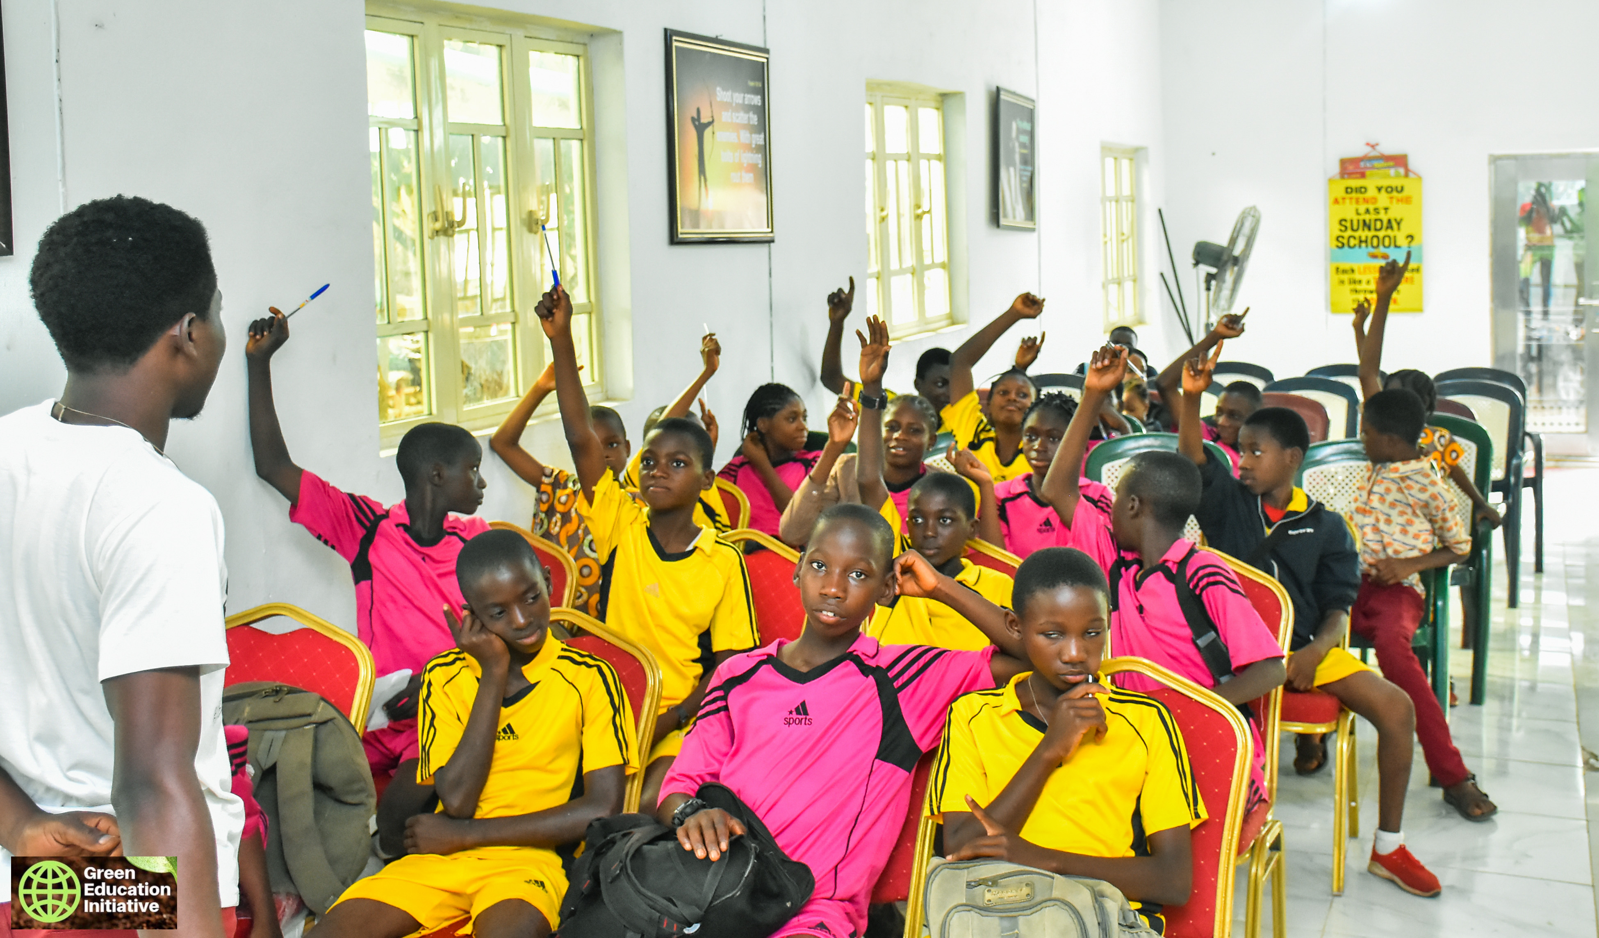
OVERARCHING GOALS
OUR OBJECTIVES ARE:
Create AWARENESS to assist individuals develop a consciousness to the total environment.
Increase KNOWLEDGE on basic environmental issues and problems.
The overarching objective of the Green Education Initiative is Environmental sustainability, protection and conservation through environmental education.
The G.E.I Project

Slide 3





The Problems
Changing Climate
WASTE GENERATION
LAND DEGRADATION
KNOWLEDGE GAP
OPEN DEFECATION
Rising temperature, draught, disease outbreaks, food scarcity are on the rise as a result of Climate Change
42 Million tonnes of Waste generated in Nigeria annually.
Reduction in soil quality, loss of soil structure, erosions, etc.
Lack of basic and fundamental knowledge on the environment and its issues
There is a pressing Open Defecation challenge in the country
The G.E.I Project

Slide 4

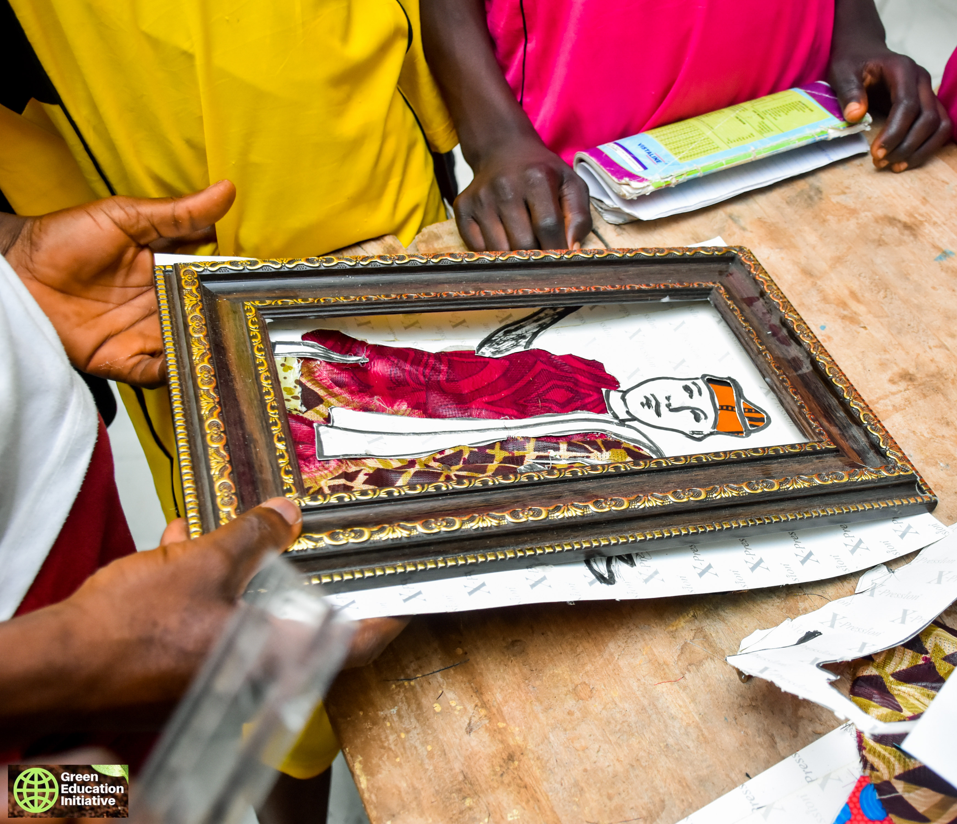



The Solution
WASTE TO WEALTH (ENTREPRENEURSHIP
ENVIRONMENTAL EDUCATION
TREE PLANTING
Train and equip children on how to turn waste to valuable items for profit
Expose students to basic environmental education to achieve behavioral change.
Engage in tree planting to stop desertification, erosion and land degradation
The G.E.I Project

Slide 5








THE CORE SDGs …
CLIMATE ACTION
At the core of this project is taking Climate Action to mitigate and adapt to climate change effects.
QUALITY EDUCATION
The G.E.I goes beyond “WHAT IS” to show you “HOW” and “WHY”.
SUSTAINABLE CITIES
This project aims to equip and build capacity for a Sustainable future for our communities and cities.
The G.E.I Project

Slide 6

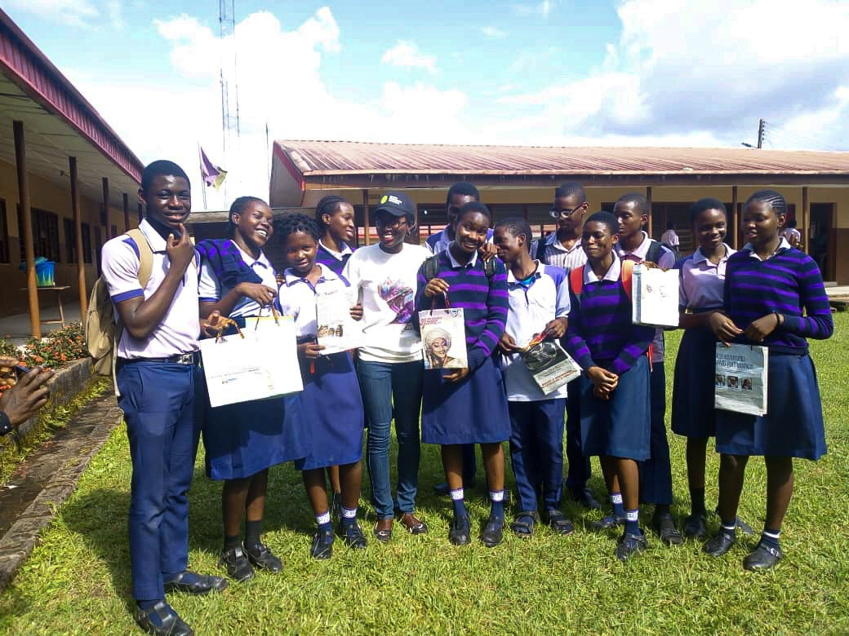
UNIQUENESS
The G.E.I is working with children at a stage where they are still very impressionable and can build positive habits.
Also …
We are working with both Private and Public Secondary schools which will provide useful data at the end of project.
The G.E.I incorporates entrepreneurship into the curriculum developing the students to save the planet and at the same time earn income.
The G.E.I Project

Slide 7

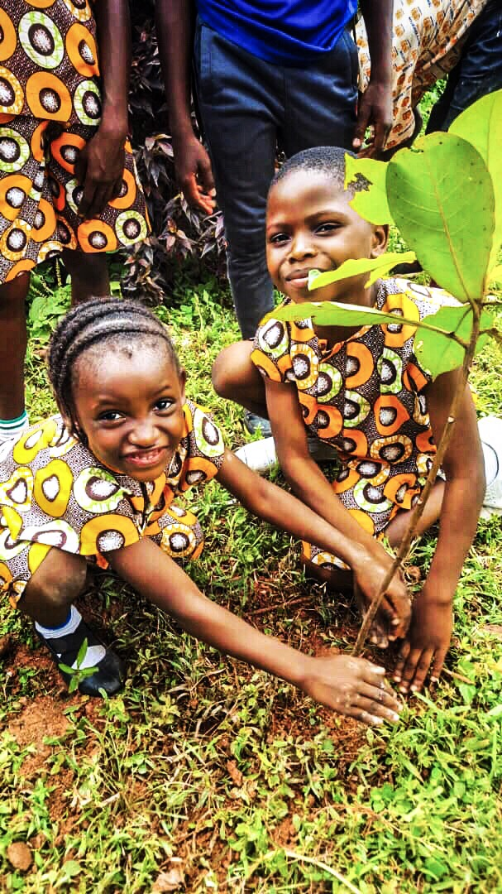
Whatever you do with your hands stays with you forever.
The kids are happy for what they can do with their hands.
The G.E.I Project

Slide 8



TRACTION.
There is an opportunity for success
SUITED/ADAPTED CURRICULUM
IMPACT
ENTREPRENEURSHIP AND SKILL ACQUISITION
The G.E.I Project has been able to successfully create a curriculum suited to our local environment.
In 6 months, the G.E.I has reached and trained over 3,000 students.
Over 1,000 students exposed directly to methods of turning waste to wealth by upcycling and recycling.
The G.E.I Project

Slide 9
Timeline
Our two-year action plan
Design
Evaluation and research
Training of Volunteers
Impact 5000 students
Feb, 2019
May, 2019
Oct, 2019
Oct, 2020
JAN
FEB
MAR
APR
MAY
JUN
JUL
AUG
SEP
OCT
NOV
DEC
JAN
FEB
MAR
APR
MAY
JUN
JUL
AUG
SEP
OCT
NOV
DEC
2019
2020
Commencement
Impacted 3000 students across 10 schools
Reach over 30 participating schools
Jun, 2019
Jul, 2020
Jan, 2020
The G.E.I Project

Slide 10
Financials
 | COST | ITEMS/ACTIVITIES | COST
EXPENSES |  | NEEDS
Training | 5,000 X 26 = 130,000 | 2 Projectors | 70,000
T-shirts/Banners/Writing Materials | 100,000 | Training Centre/Entrepreneurship Hub | 10,000,000
Transportation allowance for volunteers | 12,000/month for 6 Volunteers 6 Months = 72,000 | Project Vehicle | 5,000,000
Two Laptops | 300,000 | 2000 Tree Seedlings | 800,000
Incentives/Refreshment | 50, 000 | 10 Laptops | 1,500,000
Social Media | 30,000 | Website upload and Maintenance | 550,000
Research | 35,000 | Monitoring and Evaluation | 500,000
Curriculum | 500,000
Monitoring/Travels | 15,000
Practical Classes | 5,000/week 120,000 (6months)
Miscellaneous/Logistics | 30,000
Total |  | Total
 | 1,382,000 |  | 18,420,000
The G.E.I Project

Slide 11
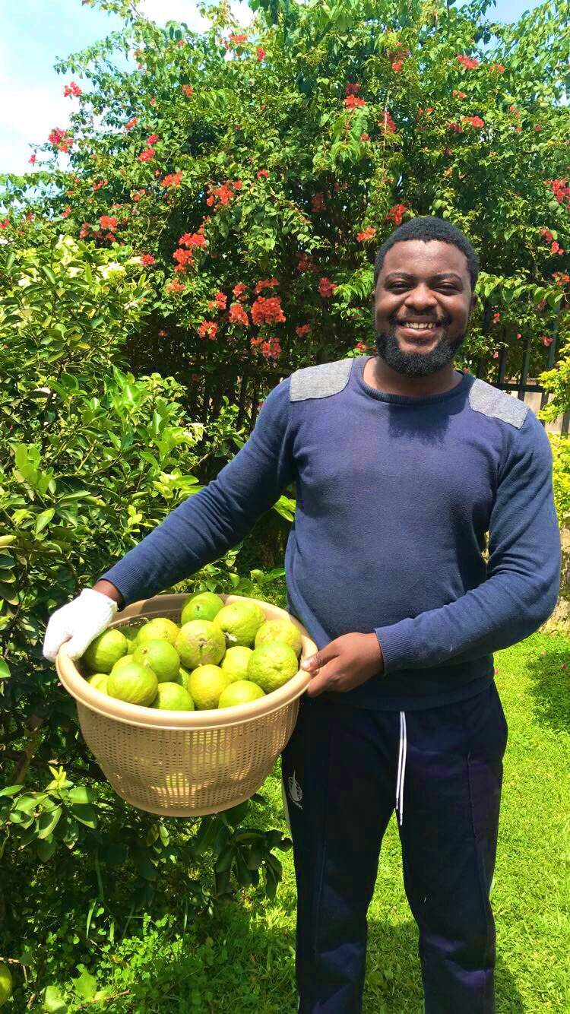





The G.E.I Project
The Team.
And 26 other VOLUNTEERS
Obaisi Alaanuloluwa
Inioluwa Oluwagbemi
Omosewa Leye-Adebayo.
Project Founder/Coordinator
Project Manager
Technical Assistant

Slide 12

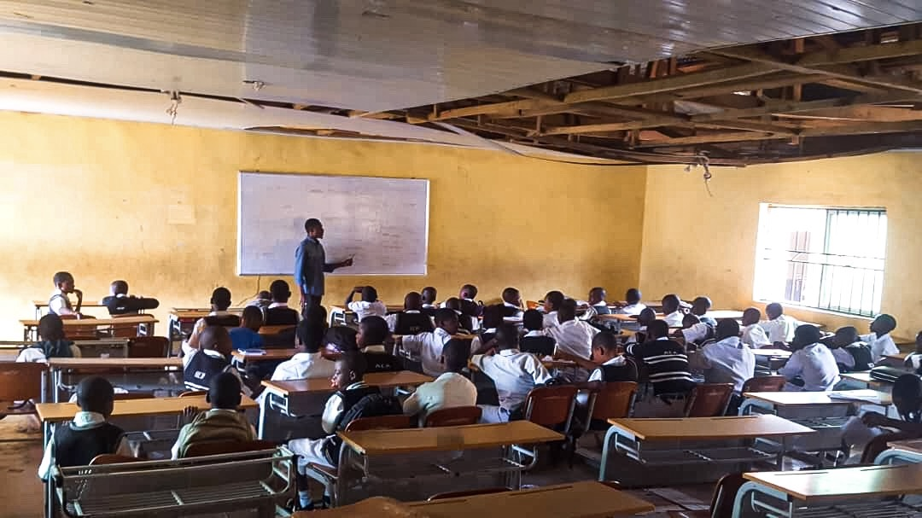
Summary
THROUGH PARTNERSHIP, WE CAN DO MORE. We want to access 30 schools and impact 5,000 students by June 2020.
It’s in our hands, the future of our great planet. Let us save the present from the future.
The G.E.I Project

Slide 13





Thank you.
Obaisi Alaanuloluwa (P.C)
+2347067558893
obaisiai@gmail.com
www.thegeiproject.com

